Slide 1

Lua
Multi-paradigm programming language

Slide 2
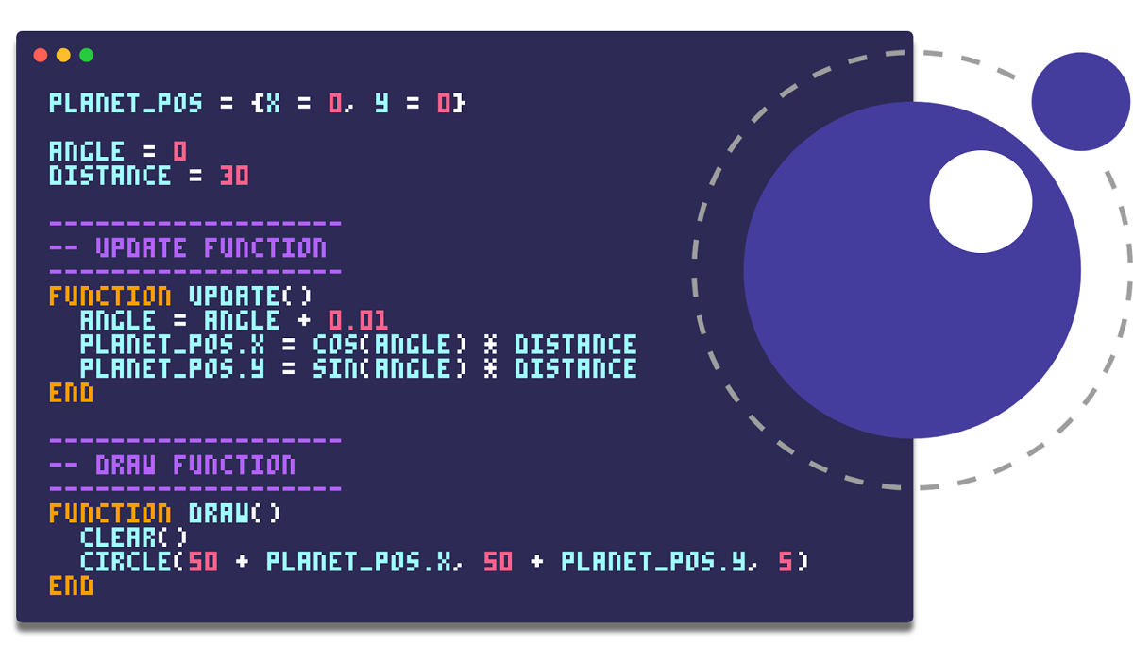
Overview
Lua is a simple, lightweight, embeddable scripting language.
Often used in game development, embedded systems, etc.
Interpreted open source language.

Slide 3

History
Lua was created in 1993 by Roberto Ierusalimschy, Luiz Henrique de Figueiredo and Waldemar Celes
Lua's predecessors were the data-description/configuration languages Simple Object Language (SOL) and data-entry language (DEL)
Roberto Ierusalimschy

Slide 4





Key features
Lightweight: Small footprint (about 1MB in size)
Fast: Efficient performance, esp. with LuaJIT
Embeddable: Easily integrated into other languages
Simple: Easy to learn and use
Portable: Runs on virtually any platform

Slide 5
Example
-- defines a factorial function
function fact (n)
if n == 0 then
return 1
else
return n * fact(n-1)
end
end
print("enter a number:")
a = io.read("*number") -- read a number
print(fact(a))

Slide 6



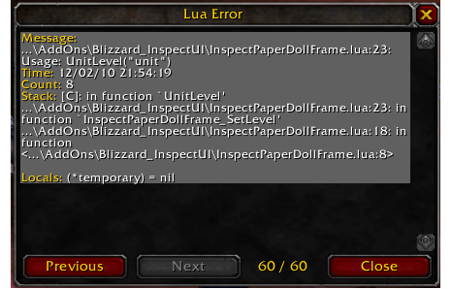
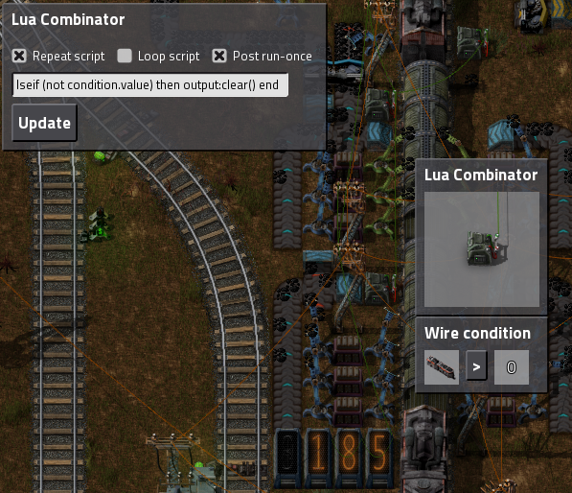
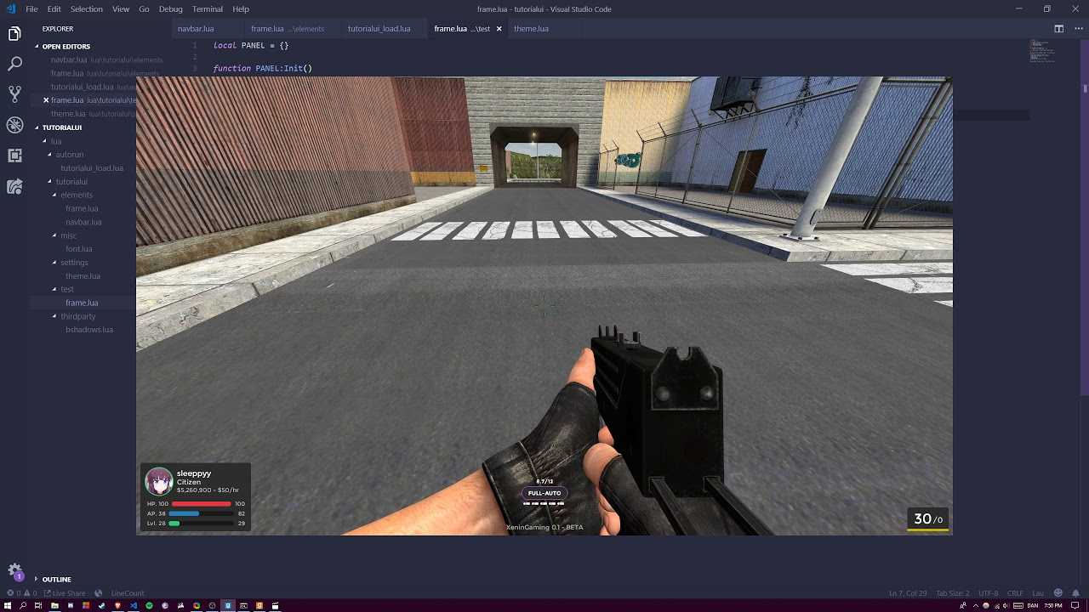
Embedded Lua

Slide 7



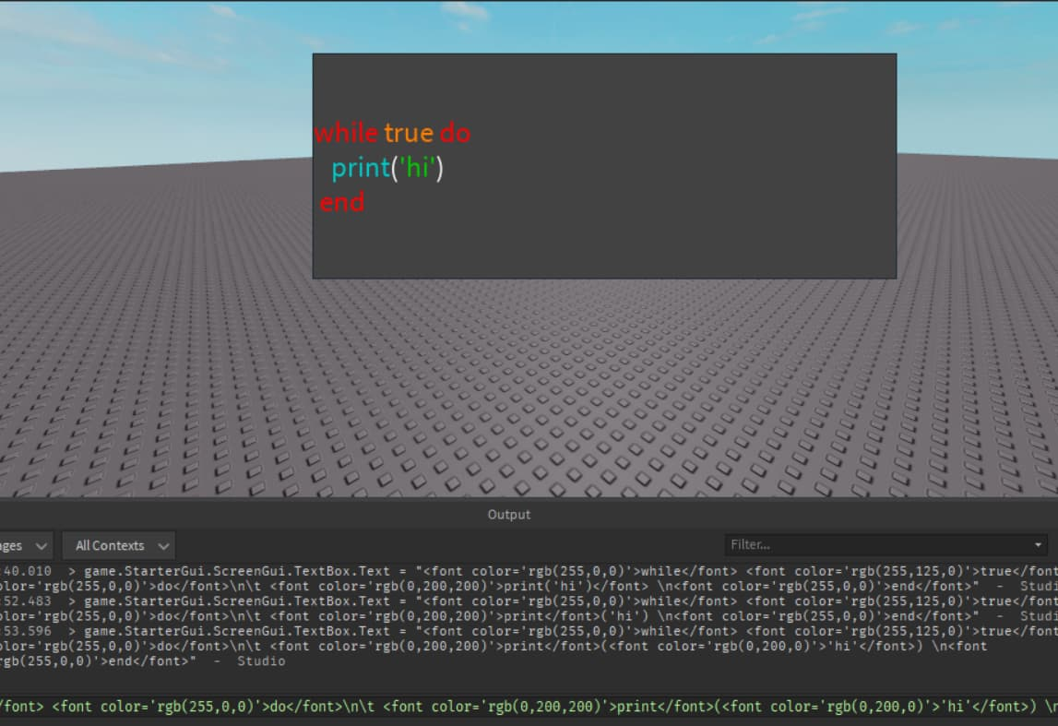


Embedded Lua

Slide 8
Lua Comparison
Python: More features, but heavier and slower
JavaScript: Web-focused, not as lightweight or embeddable
Lua: Minimalistic, fast, and embeddable
When to Use Lua:
When performance and size matter
For embedding in applications

Slide 9
Thank you for your attention.

